Slide 1
Key Principles of agile in enterprise architecture (1)

Slide 2
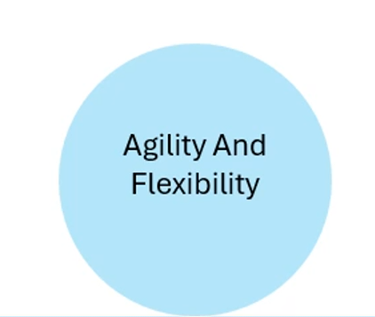
Key Principles of agile in enterprise architecture

Slide 3
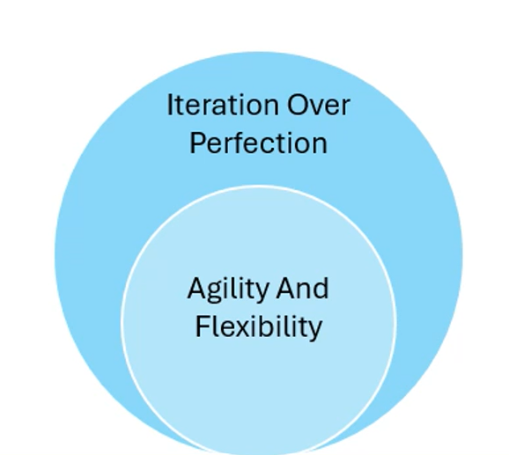
Key Principles of agile in enterprise architecture

Slide 4
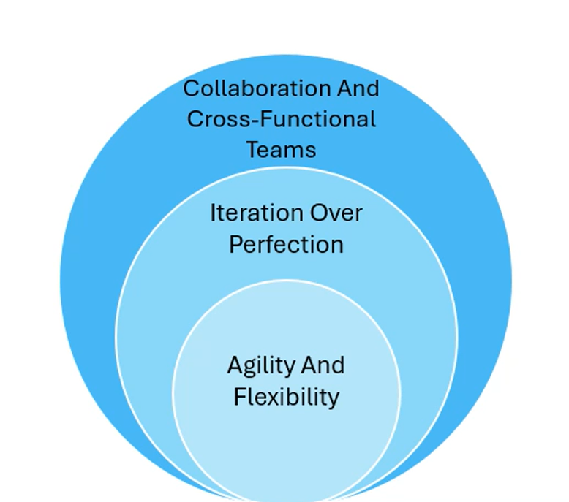
Key Principles of agile in enterprise architecture

Slide 5
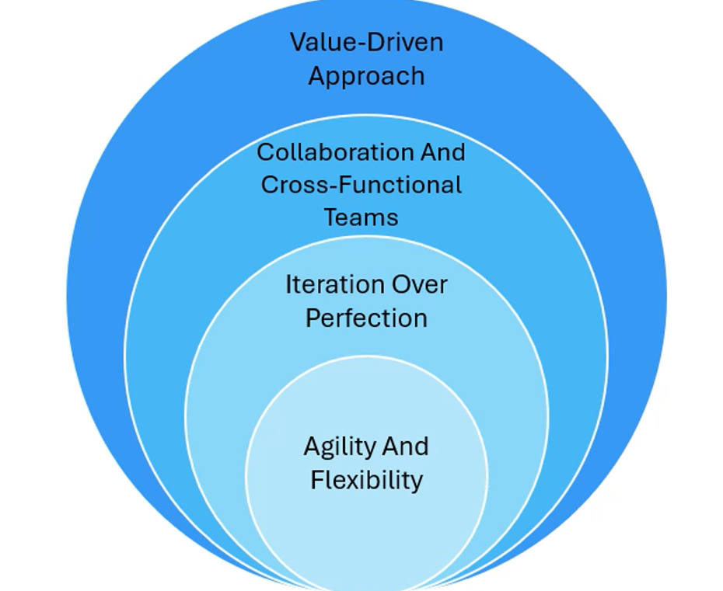
Key Principles of agile in enterprise architecture

Slide 6
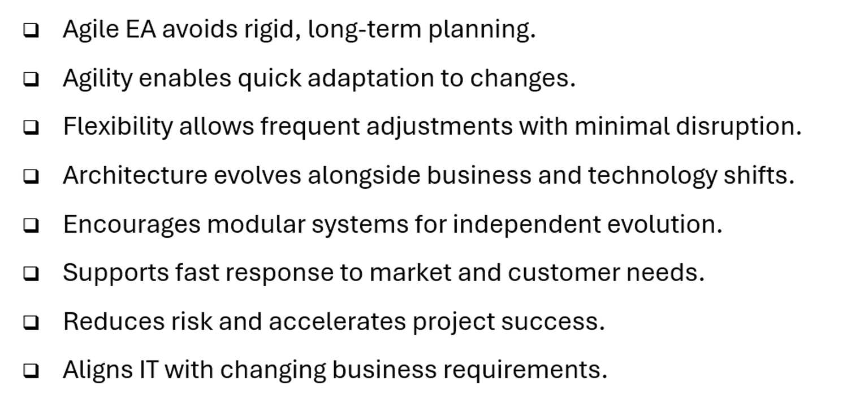
Agility and Flexibility

Slide 7
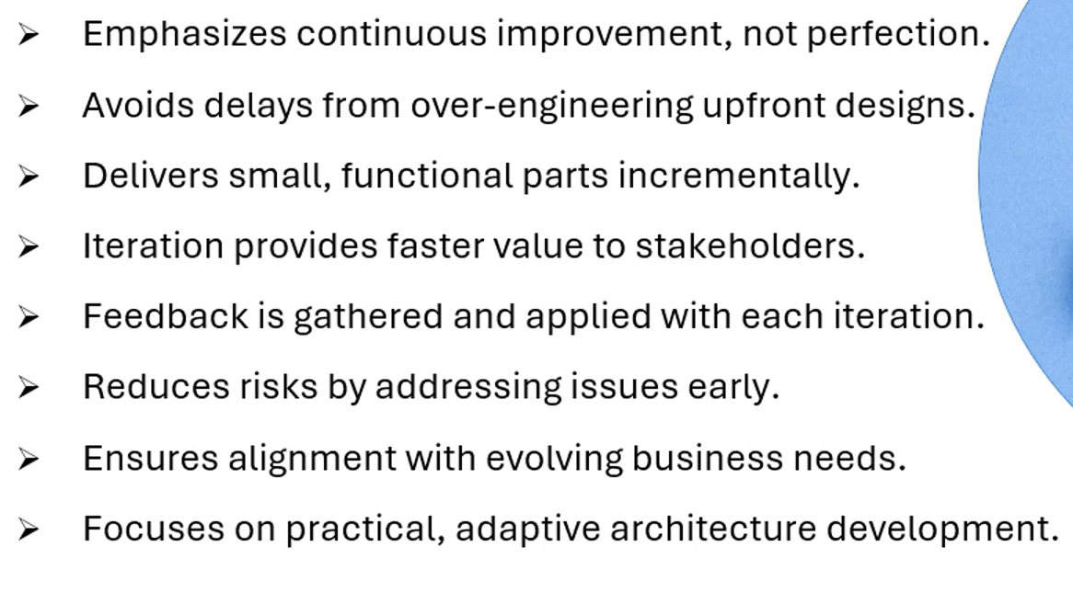
Iteration Over Perfection

Slide 8
Thank You

